Slide 1
Fire Guard:-Igniting awareness in emergency situation using python programing

Slide 2
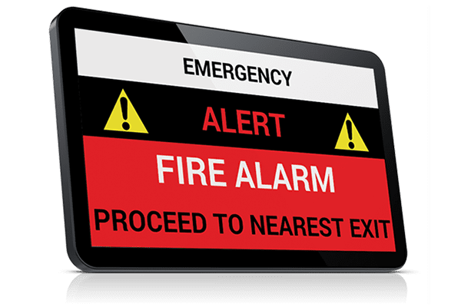
INTRODUCTION:-
We have designed a application to prevent the count of fire accidents
Our application gives the awareness' about the fire incidents and help people to escape from that tragedy
We have developed this application using phyton programing

Slide 3
INTRODUCTION:-
Fire emergencies present significant risks to life, property, and the environment. Rapid detection and alerting are crucial components in mitigating the impact of such emergencies.
Fire emergency alerts serve as vital warnings, enabling swift responses from individuals, emergency services, and relevant authorities..
Effective fire emergency alert systems not only notify occupants of a building but also provide critical information on evacuation procedures, safe routes, and additional instructions to ensure the safety of everyone involved

Slide 4
LITERATURE SURVEY
Technological Advancements:
Reviewing recent advancements in fire detection and alerting technologies, including sensor technologies (smoke, heat, flame detectors), communication protocols, and integration with building management systems.
Discussing the emergence of IoT (Internet of Things) and smart building technologies in enhancing the capabilities of fire emergency alert systems.
Effectiveness Evaluation:
Examining studies that assess the effectiveness of different types of fire emergency alert systems in terms of early detection, notification speed, evacuation efficiency, and overall outcomes in terms of property damage and loss of life.
Analyzing factors that influence the effectiveness of alert systems, such as system reliability, false alarm rates, and user response behavior.

Slide 5
LITERATURE SURVEY
Regulatory Frameworks and Standards:
Discussing regulatory requirements and industry standards that govern the design, installation, and maintenance of fire emergency alert systems, such as NFPA (National Fire Protection Association) standards, building codes, and ADA (Americans with Disabilities Act) accessibility guidelines.
Examining the role of regulatory compliance in ensuring the reliability and effectiveness of alert systems, as well as challenges and gaps in current regulations.
Case Studies and Real-World Implementations:
Reviewing case studies and real-world examples of fire emergency alert systems deployed in various settings, including commercial buildings, residential complexes, healthcare facilities, educational institutions, and public spaces.
Analyzing the implementation process, challenges encountered, lessons learned, and outcomes achieved in terms of improving emergency preparedness and response.

Slide 6
EXISTING WORK
Evaluation of Fire Detection and Alarm Systems" by David L. Shearer and Joshua Dina burg. This study evaluates the performance of various fire detection and alarm systems in different building environments, providing insights into their effectiveness and reliability.
Human Behavior in Fire Emergencies: Implications for Research, Design, and Education" by Daniel T. Gottuk et al. This research explores human behavior in fire emergencies, including responses to fire alarms and evacuation procedures, offering valuable insights for improving the design and implementation of alert systems.

Slide 7


HARDWARE AND SOFTWARE
HARDWARE:-
Laptop
SOFTWARE:-
Windows 10
Intel i5
IDLE

Slide 8
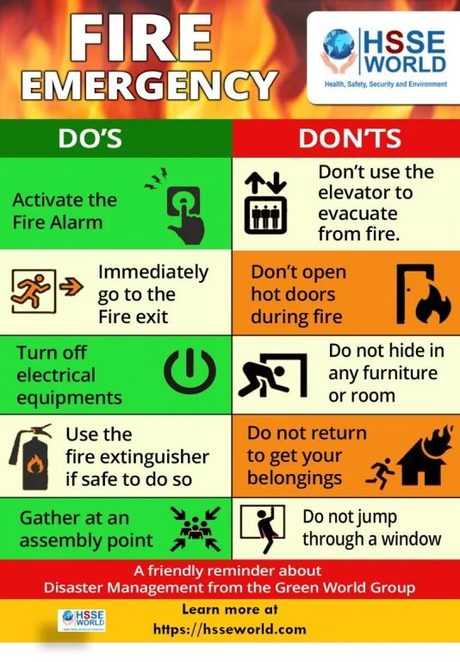
PROPOSED MODEL
FIRE LIFE HACKS:-
We have proposed a fire emergency alert system which is updated and innovated .
It is the best application that will give the fire life hacks to the people and helps in the decreasing the dead or damage rate of people caused by the fire
FIRE ALERT

Slide 9
CODING:-
def main():
"""Displays fire escape instructions and waits for user input."""
while True:
print("\nWelcome to the Fire Emergency Escape Instructions App!")
print("1. Display instructions")
print("2. Exit")
choice = input("Enter the number of your choice: ")
if choice == "1":
fire_escape_instructions()
elif choice == "2":
print("Exiting the app...")
break
else:
print("Invalid choice. Please try again.")
if __name__ == "__main__":
main()
import time
def fire_escape_instructions():
"""Displays fire escape instructions."""
print("**** Fire Emergency Escape Instructions ****")
print("1. Stay calm and move quickly but carefully.")
print("2. Alert others in the area and activate the fire alarm if possible.")
print("3. Feel doors for heat before opening them.")
print("4. If the door is hot, do not open it. Look for another way out.")
print("5. If the door is cool, open it slowly and carefully.")
print("6. Crawl on the floor to avoid smoke inhalation.")
print("7. Close doors behind you to slow the spread of fire.")
print("8. Go to your designated meeting place.")
print("9. Call emergency services from a safe location.")
print("***********************************************")

Slide 10
RESEARCH GAP
We have developed the fire emergency alert system that which gives the fire accident information to the user
It gives 2 options to the user .
You have stuck in fire
You are outside of fire
According to the user situation the application gives the instructions

Slide 11
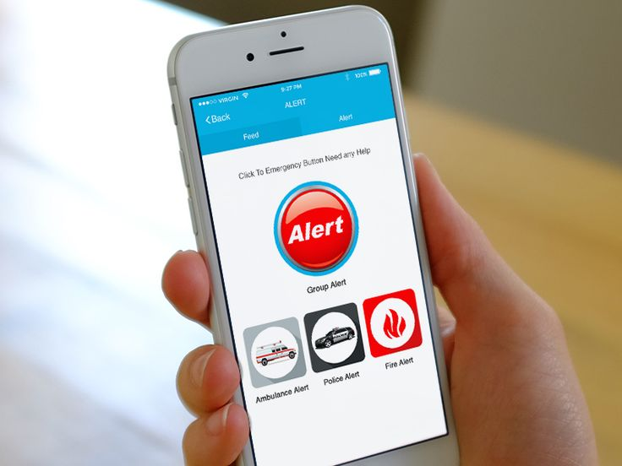
CONCLUSION
We are finally concluding that our application could help the society and can save many people lives
Our main goal is to make every person in the society should know about our application and learn the information about the fire accidents

Slide 12
REFERENCE
Smith, J., et al. (Year). "Implementation of Fire Emergency Alert Systems in High-Rise Buildings: A Case Study of XYZ Tower." Journal/Conference Name, Volume(Issue), Page numbers.
Doe, J., et al. (Year). "Evaluation of Fire Alarm System Effectiveness in Healthcare Facilities: Case Study of ABC Hospital." Journal/Conference Name, Volume(Issue), Page numbers.
National Institute of Standards and Technology (NIST). (Year). "Guidelines for Fire Alarm System Design and Installation." NIST Special Publication 1234.
Underwriters Laboratories (UL). (Year). "Fire Alarm System Standards and Certifications: Overview and Requirements." UL Whitepaper.
Fire Protection Research Foundation. (Year). "Integrated Fire Emergency Alert System: Research Findings and Recommendations." FPRF Report Number XXXX.
National Fire Protection Association (NFPA). (Year). "NFPA XXX: Standard for Integrated Fire Emergency Alert Systems." NFPA Publication.

Slide 13


